Slide 1
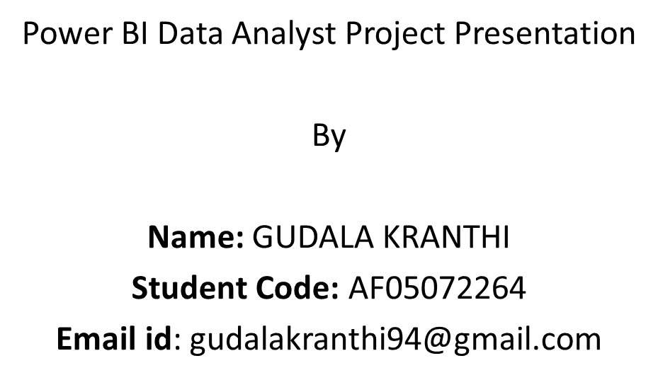
Hotel Management Dashboard

Slide 2
Hotel Management Performance Dashboard
Power BI Data Analytics Project
Includes revenue analysis, booking insights, and customer performance metrics.

Slide 3
Project Objective
Analyze hotel booking performance and revenue trends.
Answer key business questions:
- Total revenue generated
- City performance
- Room type revenue
- Booking distribution
- Monthly trends

Slide 4
Key Performance Indicators
Total Revenue: 100M
Total Rooms: 5000
Total Nights: 20K
Average Room Rate: 4.99K
Customer Rating: 4.02
These KPIs provide a quick overview of hotel performance.

Slide 5
Monthly Revenue Trend
The line chart shows monthly revenue performance across the year.
Insights:
- Higher revenue at the beginning of the year
- Slight decline in later months
- Indicates seasonal demand patterns.

Slide 6
Booking Distribution
Donut chart showing booking outcomes:
- Confirmed
- Checked-Out
- Cancelled
Insight: Majority of bookings are successfully completed.

Slide 7
Revenue by Room Type
Room types analyzed:
- Single
- Suite
- Deluxe
- Double
Single rooms generate the highest revenue.

Slide 8
Booking Channels Analysis
Bookings are distributed across:
- Travel Agents
- Direct Booking
- Online Booking
- Corporate
Online and travel agents generate significant booking volume.

Slide 9
Revenue by City
Cities analyzed:
- Hyderabad
- Mumbai
- Delhi
- Chennai
- Bangalore
Hyderabad and Mumbai generate the highest revenue.

Slide 10
Key Business Insights
Hyderabad produces the highest revenue.
Single rooms are the most profitable.
Online booking channels dominate.
Revenue shows seasonal variation.
Customer rating is strong at 4.02.

Slide 11
Conclusion
The dashboard helps management:
- Monitor revenue performance
- Identify top cities and room types
- Understand booking behavior
- Make data-driven business decisions.

